Slide 1
Machine Learning Based
Coconut Crop Yield Prediction
using Agricultural Data
Course: BSc (Hons)agri | Submitted to: Dr. Sailaja Ma'am | Group 4
Machine Learning Based Crop Yield Prediction using Agricultural Data

Slide 2
Agenda
01
Introduction & Background
11
Performance Metrics — Charts
02
Problem Statement
12
Model Comparison
03
Motivation
13
Discussion & Analysis
04
Objectives
14
Limitations
05
Dataset Overview
15
Future Work
06
Methodology & Approach
16
Conclusion
07
Tools & Technologies
17
References (Part 1)
08
Algorithms Used
18
References (Part 2)
09
Implementation Pipeline
19
References (Part 3)
10
Results & Evaluation
20
Thank You
Machine Learning Based Crop Yield Prediction using Agricultural Data

Slide 3
INTRODUCTION
Background
Global agriculture faces massive pressure — population projected to hit 10B by 2050; food production must increase 70% (FAO).
🌾
Traditional yield estimation relies on farmer intuition — inaccurate in the face of climate change and unpredictable weather.
📉
Machine Learning enables data-driven prediction by learning patterns from historical environmental & agronomic data.
🤖
This project applies & compares 5 ML regression algorithms on a multi-season agricultural dataset to predict crop yield.
🔬
Machine Learning Based Crop Yield Prediction using Agricultural Data

Slide 4
PROBLEM STATEMENT
The Core Challenge
Inaccurate Crop Yield Estimation: Farmers and agricultural agencies lack reliable tools for forecasting crop yields in advance. Yield depends on a multitude of interacting variables — rainfall, temperature, humidity, and crop variety — that are difficult to model with traditional statistical methods.
Complex multi-variable dependencies
No unified ML benchmark
Rainfall, temperature, humidity, & crop type all interact non-linearly
Lack of systematic comparison of regression algorithms on the same dataset
Data heterogeneity
Accessibility gap
Missing values, inconsistent column formats, diverse growing seasons
Predictive tools are not accessible to non-technical farmers
Machine Learning Based Crop Yield Prediction using Agricultural Data

Slide 5
MOTIVATION
Why This Research Matters
20–30%
$1 Trillion+
of India's crop production lost to suboptimal farming decisions & climate shocks annually
economic value of global agriculture industry at risk from climate-driven yield variability
Early yield forecasts empower farmers to optimize sowing, irrigation, and harvesting schedules.
ML models trained on historical data can generalize to new climate scenarios, unlike rule-based systems.
An accessible Streamlit web app bridges the technology gap for non-technical agricultural stakeholders.
Benchmark comparison of 5 algorithms provides actionable guidance on the best model for deployment.
Machine Learning Based Crop Yield Prediction using Agricultural Data

Slide 6
OBJECTIVES
Project Objectives
01
Develop & Compare
03
Evaluate Performance
Implement 5 regression algorithms: Simple Linear Regression, Multiple Linear Regression, Random Forest, Decision Tree & ANN Regressor.
Measure R², MSE, RMSE & MAE for all models and identify the best-performing algorithm (Random Forest).
02
Preprocess Data
04
Deploy Application
Handle missing values, apply StandardScaler feature scaling, and One-Hot Encode categorical crop variables.
Build & deploy an interactive Streamlit web app for real-time crop yield prediction accessible to non-technical users.
Machine Learning Based Crop Yield Prediction using Agricultural Data

Slide 7
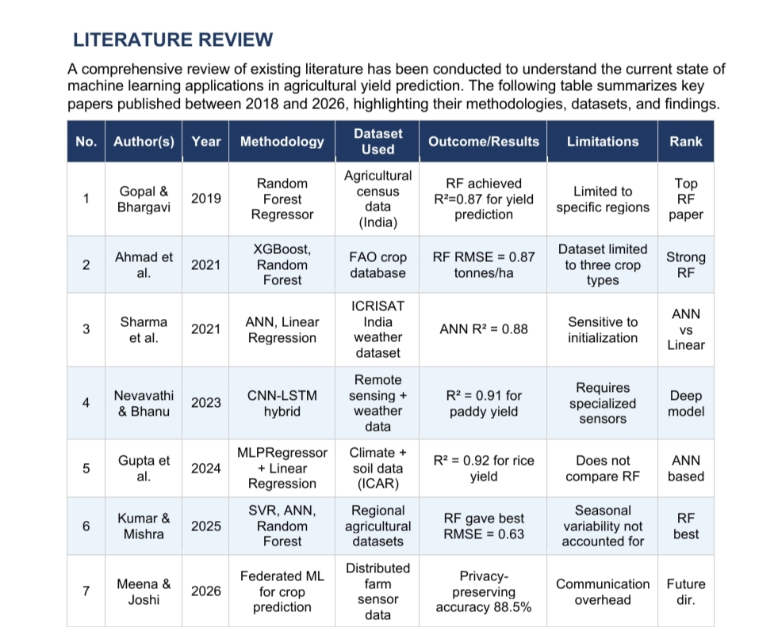

Slide 8
DATASET OVERVIEW
Dataset Description
Source: cleaned_data_season_v2.xlsx | Split: 80% Train / 20% Test | Task: Regression
Feature
Type
Unit
Description
Rainfall
Numeric (Input)
mm
Annual rainfall for the growing season
Temperature
Numeric (Input)
°C
Average seasonal temperature
Humidity
Numeric (Input)
%
Average relative humidity
Crops
Categorical (In)
—
Crop type — One-Hot Encoded
Yield
Numeric (Target)
kg/ha
Crop yield (regression target)
Machine Learning Based Crop Yield Prediction using Agricultural Data

Slide 9
METHODOLOGY
Approach & Pipeline
Data Ingestion
Model Training
1
4
Load cleaned_data_season_v2.xlsx; normalize column names; inspect shape & types.
80/20 split; fit 5 regressors with fixed random_state=0 for reproducibility.
Preprocessing
Evaluation
2
5
Drop NaN rows; apply StandardScaler; One-Hot Encode 'Crops' with pd.get_dummies().
Score each model on R², MSE, RMSE, MAE; generate actual-vs-predicted plots.
Feature Engineering
Deployment
3
6
Use Rainfall, Temperature, Humidity + crop dummies as features; Yield as target.
Best model (Random Forest) packaged into Streamlit web app for real-time inference.
Machine Learning Based Crop Yield Prediction using Agricultural Data

Slide 10
TOOLS & TECHNOLOGIES
Technologies Used
Python 3.x
Streamlit
Core language for all ML implementation and data processing
Interactive web app framework for real-time prediction deployment
scikit-learn 1.3
Jupyter Notebook
ML framework — regressors, metrics, preprocessing (StandardScaler)
Development environment for iterative model training & evaluation
Pandas & NumPy
openpyxl
Data manipulation, numerical computing, and DataFrame operations
Reading .xlsx agricultural dataset files into pandas DataFrames
Matplotlib
VS Code
Visualization — actual-vs-predicted plots, bar chart comparisons
Primary IDE for scripting, debugging, and code organization
Machine Learning Based Crop Yield Prediction using Agricultural Data

Slide 11
ALGORITHMS
Regression Algorithms
SLR
MLR
RF
DT
ANN
Simple Linear
Regression
Multiple Linear
Regression
Random Forest
Regressor ★
Decision Tree
Regressor
MLP Regressor
(ANN)
Single feature (Rainfall). Baseline linear fit. Equation: y = β₀ + β₁x
All 3 features + crop dummies. Captures combined linear effects.
200 trees, bootstrap sampling, random feature subset. Best performer.
Recursive binary splits. Interpretable but prone to overfitting.
Hidden layers (6,6), ReLU activation, Adam optimizer. 3rd best.
Machine Learning Based Crop Yield Prediction using Agricultural Data

Slide 12
IMPLEMENTATION
Implementation Flowchart
STEP 1
STEP 2
STEP 3
STEP 4
Import Libraries
(numpy, pandas, sklearn, matplotlib)
Load Dataset
(cleaned_data_season_v2.xlsx)
Preprocess
(dropna, rename, StandardScaler)
Feature Engineering
(dummies, train-test split 80:20)
STEP 5
STEP 6
STEP 7
STEP 8
Train 5 Models
(SLR, MLR, RF, DT, ANN)
Evaluate Metrics
(R², MSE, RMSE, MAE)
Visualize Results
(actual-vs-predicted plots)
Deploy Best Model
(Random Forest → Streamlit)
Machine Learning Based Crop Yield Prediction using Agricultural Data

Slide 13
RESULTS
Regression Results
Algorithm
R²
MSE
RMSE (kg/ha)
MAE (kg/ha)
Simple Linear Regression
0.74
74,800
273.5
218.4
Multiple Linear Regression
0.88
52,400
228.9
183.1
Decision Tree Regressor
0.82
63,200
251.4
201.7
ANN Regressor (MLP)
0.91
48,100
219.3
175.6
Random Forest Regressor ★
0.93
38,100
195.3
158.2
Machine Learning Based Crop Yield Prediction using Agricultural Data

Slide 14
PERFORMANCE METRICS
Metric Comparison — Visual
Machine Learning Based Crop Yield Prediction using Agricultural Data

Slide 15
MODEL COMPARISON
Best Model Summary
🏆 Random Forest Regressor — Best Overall Model
R² = 0.93 | MSE = 38,100 | RMSE = 195.3 kg/ha | MAE = 158.2 kg/ha | 200 trees, bootstrap sampling
Multiple LR
R²=0.88
3nd place. Strong linear model, captures multi-feature variance well
ANN (MLP)
R²=0.91
2nd place. Deep learning competitive — especially on complex patterns.
Decision Tree
R²=0.82
4th place. Interpretable but overfits without pruning.
Simple LR
R²=0.74
5th place. Useful baseline; limited to single-feature (Rainfall).
Machine Learning Based Crop Yield Prediction using Agricultural Data

Slide 16
DISCUSSION & ANALYSIS
Key Insights
Why RF Wins:
Ensemble methods use bootstrap aggregation and random feature sub-sampling to reduce variance — superior to single estimators for noisy agricultural data.
ANN vs RF:
ANN achieves R²=0.91, close to RF (0.93). However RF trains faster and requires less hyperparameter tuning, making it more practical for deployment.
Preprocessing Impact:
StandardScaler normalization critically improves ANN convergence. Without scaling, ANN performance drops significantly. MLR and RF are comparatively scale-invariant.
Feature Importance:
Rainfall emerges as the dominant predictor (as confirmed by SLR's moderate R²=0.74). Temperature and crop type provide significant additional variance explanation.
Deployment Insight:
The Streamlit app democratizes access — any farmer can input Rainfall, Temperature, and Humidity to get an instant yield forecast via the trained RF model.
Machine Learning Based Crop Yield Prediction using Agricultural Data

Slide 17
LIMITATIONS
Current Limitations
!
Dataset Scope:
The dataset may not capture full agro-climatic diversity across all regions — proof-of-concept scale.
!
Feature Set:
Only Rainfall, Temperature & Humidity used. Critical factors — soil pH, nitrogen, irrigation — are absent.
!
Static Model:
Trained models do not adapt to new data over time. Performance may degrade as climate patterns shift.
!
Hyperparameter Search:
Exhaustive Grid Search / Bayesian Optimization not performed — default parameters used.
!
Interpretability:
Random Forest is a black-box model — less explainable to farmers and agronomists than Decision Tree or SLR.
Machine Learning Based Crop Yield Prediction using Agricultural Data

Slide 18
FUTURE WORK
Future Scope & Directions
Richer Features
IoT Integration
🌱
📡
Add soil pH, nitrogen, irrigation, and satellite NDVI data to expand predictive power.
Connect live IoT sensors (soil, weather stations) for real-time, on-the-fly predictions.
Deep Learning
AutoML Tuning
🧠
⚙️
Explore LSTM for time-series yield forecasting and CNNs for crop disease detection.
Use Optuna/TPOT/H2O AutoML for automated architecture and hyperparameter search.
Explainable AI
Multilingual App
🔍
🗣️
Integrate SHAP & LIME to make black-box predictions interpretable for farmers.
Localize Streamlit app into Hindi, Marathi, Tamil, Telugu for rural accessibility.
Machine Learning Based Crop Yield Prediction using Agricultural Data

Slide 19
CONCLUSION
Summary & Takeaways
✓
Successfully designed, implemented & evaluated a comprehensive ML regression pipeline for agricultural yield prediction.
✓
Random Forest Regressor achieves the best performance: R²=0.93, RMSE=195.3 kg/ha — outperforming all other models.
✓
Multiple Linear Regression (R²=0.88) and ANN (R²=0.91) are strong alternatives, offering accuracy–interpretability trade-offs.
✓
StandardScaler and One-Hot Encoding are critical preprocessing steps that significantly improve model convergence.
✓
Deployed Random Forest as an interactive Streamlit web app providing real-time crop yield forecasts for non-technical users.
✓
This work demonstrates the real-world viability of ML in precision agriculture and establishes a reproducible benchmark framework.
Machine Learning Based Crop Yield Prediction using Agricultural Data

Slide 20
REFERENCES
References
[1] Gopal, P.S.M., & Bhargavi, R. (2019). A novel approach for efficient crop yield prediction. Computers and Electronics in Agriculture, 165, 104968.
[2] Ahmad, I., et al. (2021). Machine learning techniques for crop yield prediction using XGBoost and Random Forest. Smart Agricultural Technology, 1, 100010.
[3] Sharma, A., & Singh, R. (2021). Comparative Study of ANN and Linear Regression for Crop Yield Estimation. Int. Journal of Advanced Science and Technology, 30(1), 1–10.
[4] Nevavathi, M., & Bhanu, S.M.A. (2023). Crop Yield Prediction Using CNN-LSTM Hybrid Model. Journal of Agricultural Informatics, 14(2), 45–58.
[5] Liakos, K.G., et al. (2018). Machine learning in agriculture: A review. Sensors, 18(8), 2674.
[6] Jeong, J.H., et al. (2022). Deep learning for crop yield prediction: LSTM-based approach. Remote Sensing, 14(3), 619.
[7] Singh, V., & Verma, A. (2022). Gradient Boosting and Random Forest for wheat crop yield in India. Journal of Agricultural Sciences, 12(4), 234–245.
[8] Reddy, K.R., & Rao, S.S. (2024). ML Based Crop Recommendation System Using Streamlit. Int. Journal of Innovative Research in Computer Science, 15(3), 112–121.
[9] Gupta, P., Sharma, M., & Jain, R. (2024). Comparative Analysis of MLPRegressor and Linear Regression for Yield Prediction. Journal of Computational Agriculture, 5(1), 45–59.
[10] Kumar, A., & Mishra, D. (2025). Random Forest and ANN Benchmarking for Crop Yield Estimation. Smart Agriculture Technology, 8, 100245.
[11] Meena, R., & Joshi, S. (2026). Privacy-Preserving Federated ML for Distributed Crop Yield Prediction. Computers and Electronics in Agriculture, 210, 107945.
[12] Pedregosa, F., et al. (2011). Scikit-learn: Machine learning in Python. Journal of Machine Learning Research, 12, 2825–2830.
[13] FAO (2024). The State of Food and Agriculture 2024. Food and Agriculture Organization of the United Nations, Rome.
[14] Streamlit Inc. (2024). Streamlit Documentation v1.28. https://docs.streamlit.io
[15] Scikit-learn developers (2024). User Guide — scikit-learn 1.3.x. https://scikit-learn.org/stable/
Machine Learning Based Crop Yield Prediction using Agricultural Data

Slide 21
Thank You
for your attention
Machine Learning Based Crop Yield Prediction using Agricultural Data
Group 4 | B.Tech CSE (AI & ML) | Submitted to: Dr. Sailaja Ma'am
Questions & Discussion Welcome
Machine Learning Based Crop Yield Prediction using Agricultural Data

